Slide 1
FDS Review
在此输入您的封面副标题

Slide 2
课程评分方法 (Grading Policies)
 Lecture Grade (75) = Homework Exercises (10)
+ Quizzes (10)
+ Mid-Term Exam (15*)
+ Final Exam (40*)
 Laboratory Grade (25) =

Slide 3
考题类型与考试范围
与平时作业和期中考试的题型一样
判断题
选择题
填空题
函数题
范围：chapter2-9
重点：chapter4 trees(33), chapter9 graphs(28),chapter6 Heaps(16),chapter7 Sorting (8)

Slide 4
Chapter 2 Algorithm Analysis
5 criteria
(1) Input There are zero or more quantities that are externally supplied.
(2) Output At least one quantity is produced.
(3) Definiteness Each instruction is clear and unambiguous.
(4) Finiteness If we trace out the instructions of an algorithm, then for all cases, the algorithm terminates after finite number of steps.
(5) Effectiveness Every instruction must be basic enough to be carried out, in principle, by a person using only pencil and paper. It is not enough that each operation be definite as in(3); it also must be feasible.
An algorithm can be described by human languages, flow charts, some programming languages, or pseudo-code.

Slide 5
单击此处添加标题
Time & space complexities: Asymptotic Notation ( Ο, Ω, Θ, o )
Ο: T (N) = O( f (N) ) if there are positive constants c and n₀ such that T (N) ≤ c ⋅ f (N) for all N ≥ n₀.
T_{avg}(N) & T_{worst}(N)
O(1), O(logn), O(n), O(nlogn), O(n²), O(2^{n}), ……
Examples
Factorial(N)
Fib(N)
BinarySearch(A[], N, X)
Gcd(M,N)
POW(X, N)

Slide 6
Chapter 3 Lists
linear lists: Arrays vs. Linked Lists
Insert, Delete, Find
the use of header node
doubly linked lists
circularly linked lists
stack vs queue
stack
queue
applications

Slide 7
Chapter 4 trees
trees vs binary trees：left-child, right-sibling
some special binary trees:
travesals of binary tree: level-order, pre-order,in-order, post-order
binary search tree: find, insert,delete
applications
examples

Slide 8
Chapter5 Hashing
Hash functions f(x)
collision resolution
seperate chaining
open addressing-linear probing, quadratic probing

Slide 9
Chapter6 Priority Queues (Heaps)
binary heap-complete tree based structure
min heap
max heap
insert,delete
percolate down vs percolate up
applications
the selection problem
heapsort

Slide 10
Chapter7 Sorting
comparison-based sorting
selection sort
bubble sort
insert sort-shell sort
heapsort, mergesort, quicksort
non-comparison based sorting
bucket sort
radix sort

Slide 11
Chapter8 Disjoint set
FIND-UNION algorithm
Smart Union: Union-by-size, Union-by-height
Path Compression

Slide 12
Chapter9 Graph
Representation of Graphs-adjacency matrix vs adjacency lists,
algorithms
topological sort
Dijkstra's algorithm for weighted shortest path
critical path analysis
maximum flow
Minimum spanning tree: Prim's algorithm vs Kruskal's algorithm
DFS and applications

Slide 13
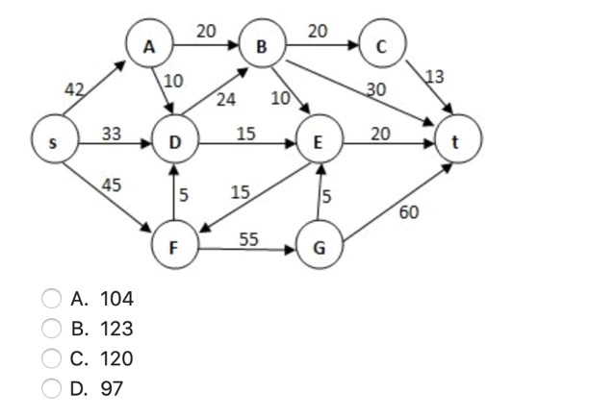
单击此处添加标题

Slide 14
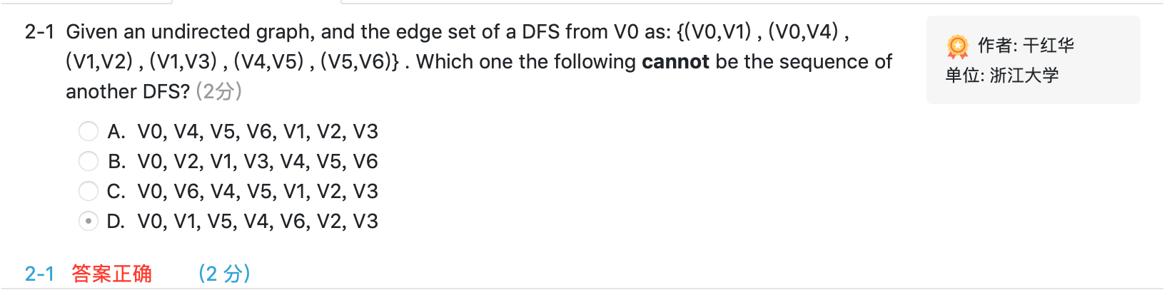
单击此处添加标题

Slide 15
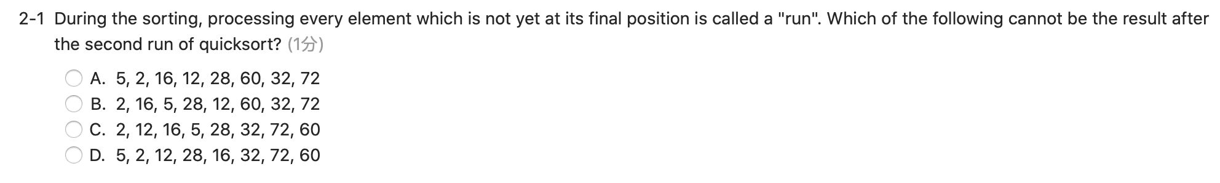
单击此处添加标题

